Slide 1
Digital Portfolio
STUDENT NAME :S SARULATHA
REGISTER NO AND NMID :2413101805222016 AND
59E6D2D1BDB29DBA1664116AAAD02CB5
DEPARTMENT :B. SC DATA SCIENCE
COLLEGE: COLLEGE/ UNIVERSITY: SHARE RAGHAVENDRA ARTS AND SCIENCE
COLLEGE,KEEZHAMOONGILADI AFFILIATED
TO ANNAMMALAI UNIVERSITY,CHIDAMBARAM

Slide 2
PROJECT TITLE
DIGITAL PORTFOLIO
A Digital Portfolio is a personal website that displays an
individual’s skills, education, projects, and achievements in a
well-organized and attractive format.It is designed using
HTML, CSS, and optionally JavaScript to Create a simple
and responsive layout.

Slide 3


AGENDA
Problem Statement
Project Overview
End Users
Tools and Technologies
Portfolio design and Layout
Features and Functionality
Results and Screenshots
Conclusion
Github Link
3/21/2024 Annual Review

Slide 4

PROBLEM STATEMENT
Problem statement
To design and develop a personal portfolio website for a data science student that
displays details such as profile, education, skills, and contact information in
a simple and responsive manner.
The website should:
Provide smooth navigation across sections like Home, About, Skills,
Education, and Contact.
Present information clearly with an attractive layout.
Work on both mobile and desktop devices.

Slide 5

PROJECT OVERVIW
1. Project Title:Personal Digital Portfolio
S.sarulatha Data science Student
2. Objective: To design and develop a responsive
portfolio website to showcase academic background,
skills, and contact details professionally.
Project Overview – Digital Portfolio Website

Slide 6
PROJECT OVERVIEW
3.Key Features:
Navigation Bar – Links to Home, About, Skills, Education, and
Contact sections.
Hero Section – Displays name, title, location, and social links.
About Section – Overview of education and career interests.
Skills Section – Programming skills in Python, html,css and js
Education Section – Academic details and learning focus.
Contact Form – Allows visitors to get in touch via email.
Responsive Design – Compatible with mobile and desktop devices.

Slide 7
PROJECT OVERVIEW
4. Technologies Used:
HTML5 – Structure of the website.
CSS3 – Styling and layout design.Font Awesome – Icons
for visual enhancement.
JavaScript – Interactive features (toggle menu, contact
form).
5. Expected Outcome:
A professional-looking personal portfolio website that
highlights academic and career achievements, helping in
internships, job applications, and professional
networking.

Slide 8

WHO ARE THE END USERS?
1.Potential Employers / Recruiters
• To review your skills, education, and contact information
for internships or job opportunities.
2. College Faculty / Academic Evaluators
• To assess your project work, presentation, and technical
knowledge.
3. Peers / Collaborators
• Fellow students, developers, or friends who may want to
collaborate on projects.
4. General Visitors
• Anyone interested in learning about your background,
skills, and academic journey.

Slide 9

TOOLS AND TECHNIQUES
Tools Used
HTML5 – Structure and content of the
website.
CSS3 – Styling, layout, and visual design.
Font Awesome – Icons for navigation and
sections.
JavaScript – Interactivity (menu toggle,
form handling).
Code Editor(codepen/ easy coder web)–
For writing and edit Chrome code.
Web Browser(Chrome)– For testing and
running the website.

Slide 10
TOOLS AND TECHINIQUES
Techniques Used
Responsive Web Design (RWD) – Ensuring
website works on mobile, tablet, and desktop.
Navigation Bar Design – Smooth section linking
for user-friendly experience.
Section-Based Layout – Dividing content into
Hero, About, Skills, Education, and Contact
sections.
Form Handling Technique – Collecting user input
in the contact form.
Use of External Libraries – Font Awesome for

Slide 11
POTFOLIO DESIGN AND LAYOUT
Design
Minimal & Professional Look – Clean and simple interface
with a focus on content.
Font Awesome Icons– For visual appeal and navigation
clarity.
Color Scheme – Soft background with readable text
contrast.
Typography – Clear headings and readable body text.
11

Slide 12
PORTFOLIO DESIGN AND LAYOUT
Layout
Navigation bar– Fixed menu with Home, About, Skills, Education, and
Contact sections.
Hero Section – Name, title, location, and quick action buttons
(LinkedIn, Contact).
About Section – Personal introduction and highlights (Education
Focus, Interests, Goals).
Skills Section – List of technical skills (Python, html,css,js)
Education Section – Details of academic background and highlights.
Contact Section – Contact details, social links, and message form.
Footer – Copyright and brief info.

Slide 13
FEATURES AND FUNCTIONALITY
Features
1.Responsive Design – Works on desktop,
tablet, and mobile.
2. Navigation Bar – Easy access to all sections
(Home, About, Skills, Education, Contact).
3. Hero Section – Profile name, title, and
location displayed prominently.
4. Interactive Buttons – LinkedIn and contact
links open directly.
5. Font Awesome Icons – For better visual
representation of sections.
6. Contact Form – Users can send messages
directly.
7. Footer – Displays copyright and basic
informatio

Slide 14
FEATURES AND FUNCTIONALITY
Functionality
Smooth Scrolling between
sections using navigation links.
Clickable Social Media Buttons to
redirect to LinkedIn.
Form Submission to collect visitor
messages (can be linked to email
or database in future).
Mobile-Friendly Layout ensuring
proper alignment across all
devices.

Slide 15

RESULTS AND SCREENSHOT
Results
A fully functional personal digital portfolio website was
created.
Showcases profile, education, skills, and contact
information in an interactive layout.
Responsive design works seamlessly on desktop and
mobile devices.
Provides easy navigation and direct LinkedIn integration.

Slide 16
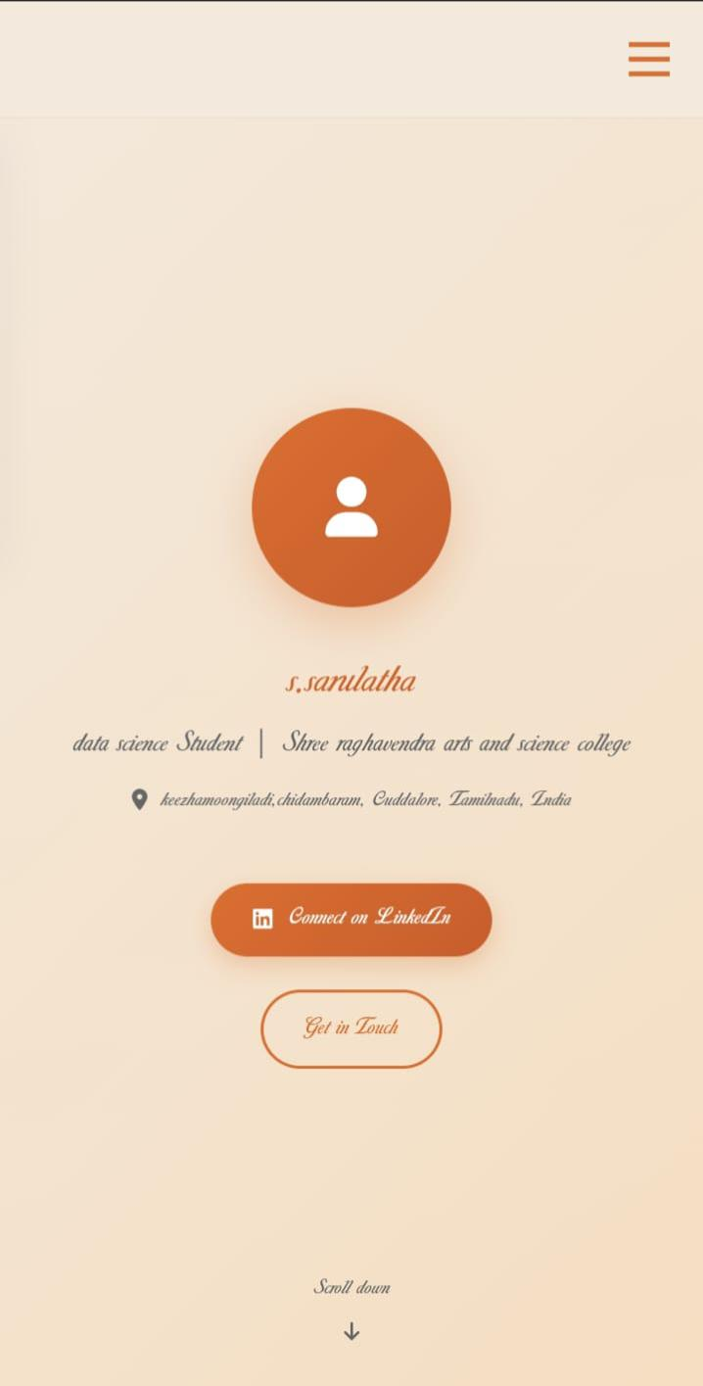
RESULTS AND SCREENSHOTS
Homepage– Showing name, title, and avatar.
3/21/2024 Annual Review
16

Slide 17
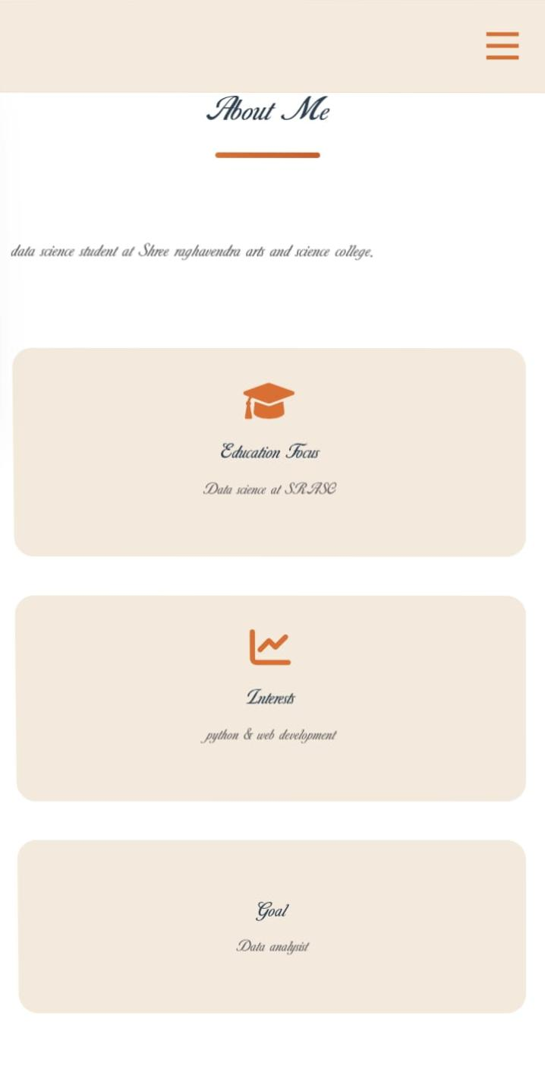
AboutSectionDisplaying bio andhighlights:

Slide 18
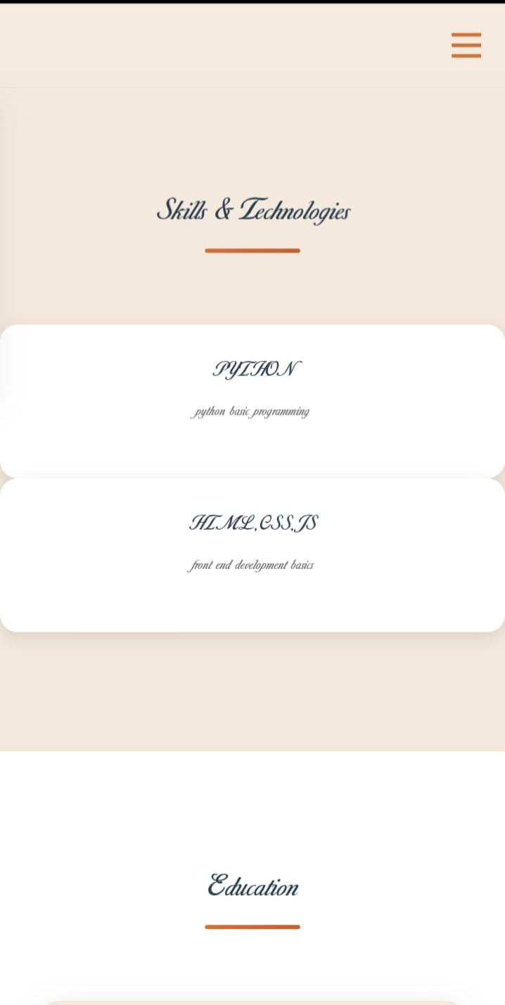
Skills Section – Listing programming languages:

Slide 19
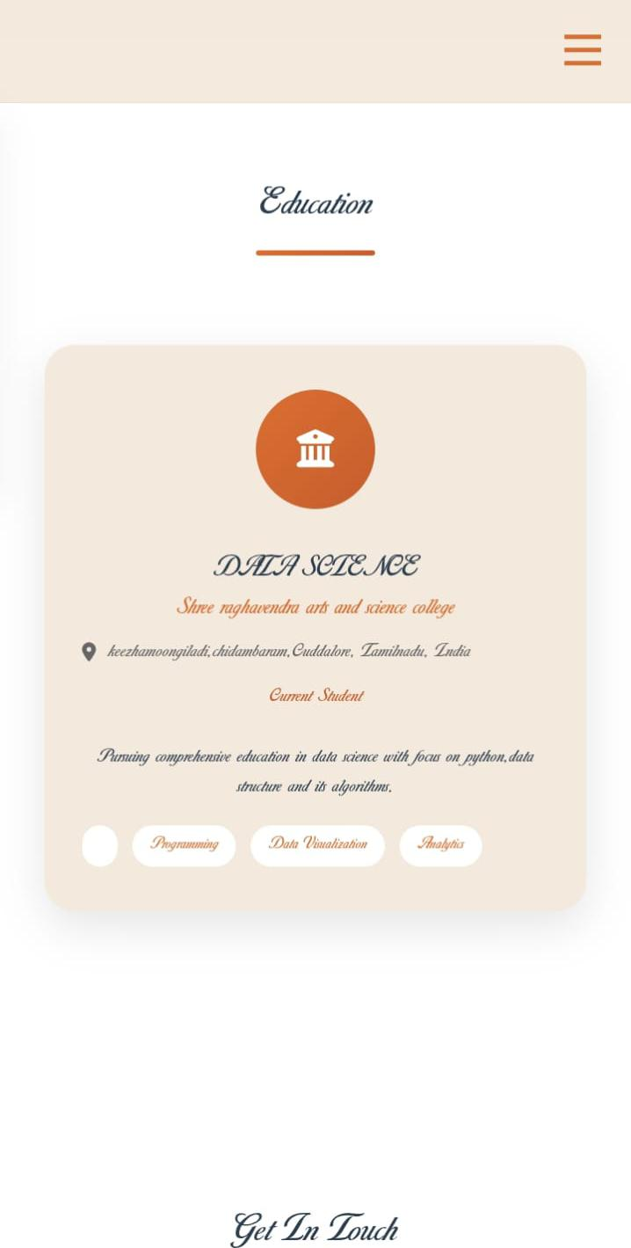
Education Section – College name, course, and highlights:

Slide 20
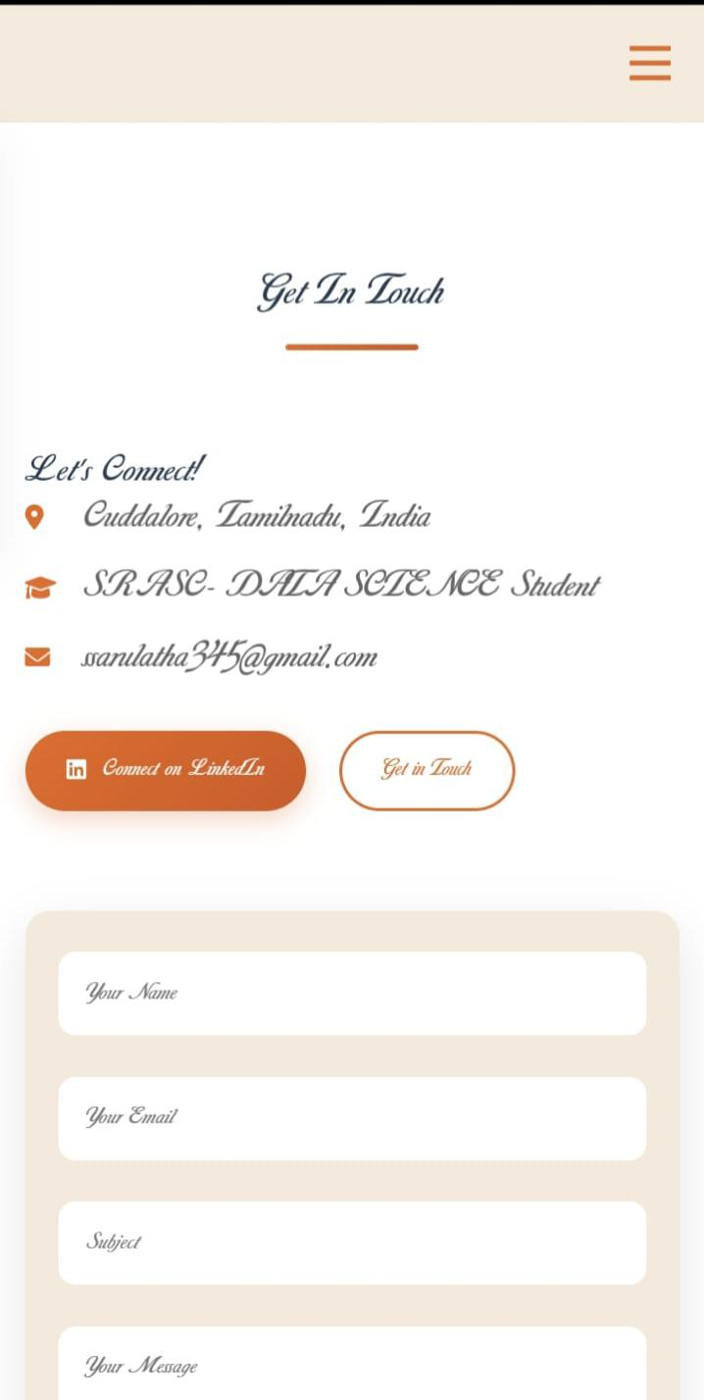
Contact Section – Email, LinkedIn, and contact form:

Slide 21
CONCLUSION
Conclusion for Digital Portfolio Project
“The Digital Portfolio effectively
showcases my personal profile, academic
background, technical skills, and career
aspirations in an organized and visually
appealing format. It serves as a
professional platform for potential
employers, faculty, and collaborators to
learn about my abilities and
achievements. The project demonstrates
my knowledge of web development using
HTML, CSS, and JavaScript and highlights
my capability to create user-friendly and
responsive designs.”
“THANK YOU”
21

